Slide 1
Do More with Less in SMB
Partner Deck
Notes:
This deck will:
Provide an understanding of what the Do More with Less in SMB campaign is about
Show the partner opportunity in helping SMBs to do more with less with Microsoft 365
Land the new messaging, assets, and SMB New Customer and Upsell Promo to partners to help them acquire new customers and upsell existing customers.

Slide 2

Microsoft 365 empowers you to Do More with Less
“No company is better positioned than Microsoft to help organizations deliver on their digital imperative so that they can do more with less. From infrastructure and data to business applications and hybrid work, we provide unique differentiated value to our customers.”
– Satya Nadella, CEO
Notes:
Talk Track: Today, every business, in every industry, is looking to do more with less. Organizations of all sizes require a digital fabric that connects people, places, and processes--creating a massive opportunity to help customers make hybrid work, work. Additionally, pressures from the evolving global economy are requiring businesses to reduce costs and optimize operations as they continue to shift to a world of hybrid work. Satya shared his views on how Microsoft can help organizations to deliver on their digital imperative so that they can do more with less in this current economic environment and provide differentiated value to our customers.

Slide 3
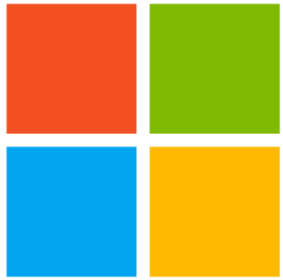
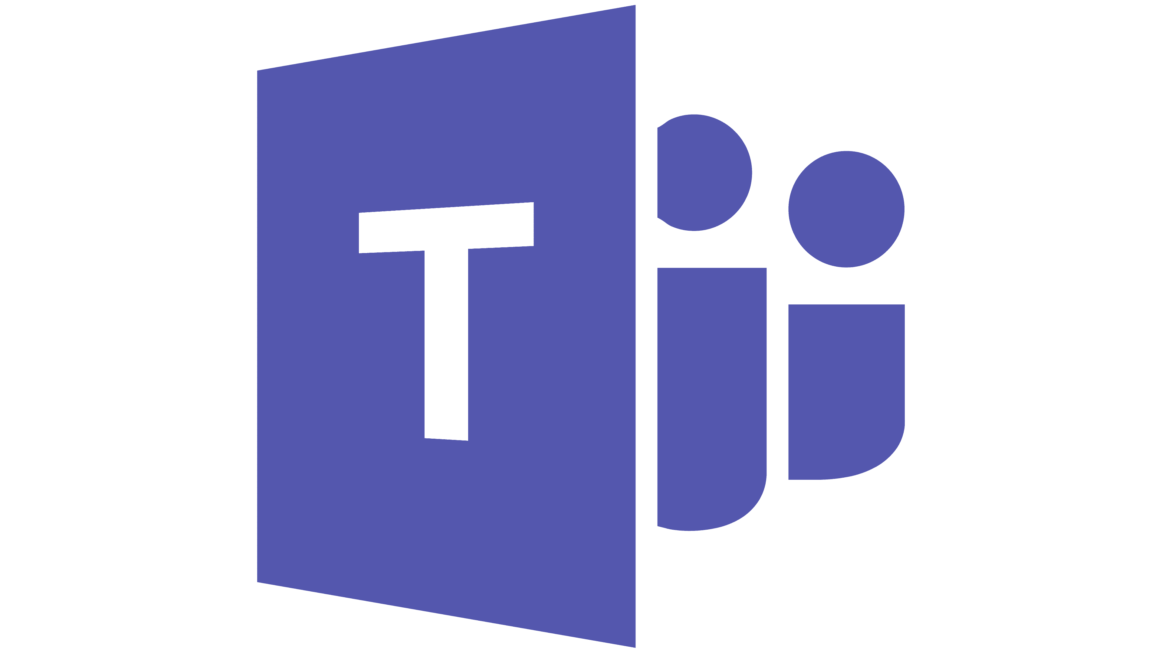
Microsoft 365 delivers on the power of the cloud
Save Costs
Increase Security Confidence
Improve Productivity
Consolidate your apps into one Microsoft 365 suite
Simplify deployment with single sign on experience for easier access
Reduce application licensing and management complexity
Securely access your data from anywhere
Reduce risk of expensive data breach incidents
Keep your devices safe wherever they are, across platforms
Connect professionally with customers from anywhere
Adopt hybrid business practice to ease travel expense
Reduce office space leasing and utilities costs
Realize Value
Save over 50% through license consolidation to Microsoft 365
Reduce data breach risk by 45% and security management costs by 50%
Enable 51% more collaboration and reduce travel expenses by 32%
Notes:
The multiple capabilities needed to enable Hybrid Work— meetings, chat, phone, scheduling, project management, cloud storage, analytics and automation, security — can easily increase an organization’s total cost of ownership and the administrative complexity that accompanies adding, deploying, and managing each solution separately.
Microsoft 365 brings these solutions together into one integrated experience that delivers on the power of the cloud and makes Hybrid Work easier and smarter for employees. Microsoft 365 provides a complete solution for SMBs, providing the most powerful and modern tools to do more with less. Customers can save money through vendor consolidation and decreased travel, increase security, and improve productivity and collaboration all with one premium product.

Slide 4

What do SMBs want?
64%
of SMB buyers prefer to purchase software solutions as a package or “suite of solutions” that meets all their business needs.¹
Meeting the Changing Software Technology Needs of SMBs, Forrester Consulting, September 2022
Notes:
And we see this message resonating with SMBs. In a Forrester survey of 470 SMBs tech buyers, 64% prefer to purchase a suite of solutions to meet all their business needs. This “one-stop shopping,” to have one vendor provide all their tech needs, aligns with Microsoft 365 set of offerings and is an opportunity for our partners to help SMBs do more with less..

Slide 5


Opportunity to help SMBs do more with less
01
02
Work with customers to find and implement the right solutions for their needs
Offer value-added, managed services for greater profitability
Hybrid work and security are all still important to SMBs
1 in 4 SMBs state they experienced a cyberattack in the last year.¹
73% of workers say they want flexible remote work options.²
Smooth out cash flows and create longer-term opportunities to add additional revenue streams
Managed services opportunities grew 18%³
For any given workload, margins ranged from 30% up to 65%, depending on the maturity of the offering.³
Microsoft SMB Research, April 2022, Security in the new work environment
Meeting the Changing Software Technology Needs of SMBs, Forrester Consulting, September 2022
The Partner Opportunity For Microsoft Modern Workplace, Forrester Consulting, July 2022
Notes:
Now is the time to work with your customers, to understand their needs, and implement the right solution for hybrid work and security.
1 in 4 SMBs state they experienced a cyberattack in the last year and 54% of the SMB respondents in the Forrester survey ranked “security and compliance risks in working with 3rd parties” as a top challenge when considering purchasing solutions for employees. On top of that, workers continue to want flexible remote work options. These are still critically important for small businesses to run their business and do more with less. Partners should think of this opportunity as not just a license rightsizing conversation but a needs conversation.
On top of that, partners who aren’t yet doing so, should offer value-added managed services.
The overall managed services opportunity in the SMB space grew 18% in FY22 and for partners who offer managed services, margins can range anywhere from 30% up to 65%, for a given workload, depending on the maturity of the offering. So for partners, there’s an opportunity for greater profitability, to smooth out cash flows, and to create longer-term sustainable relationships with your SMB customers.

Slide 6

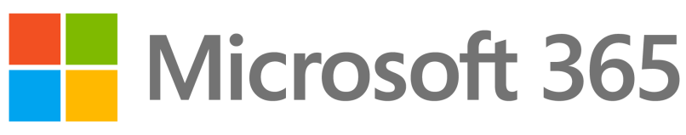

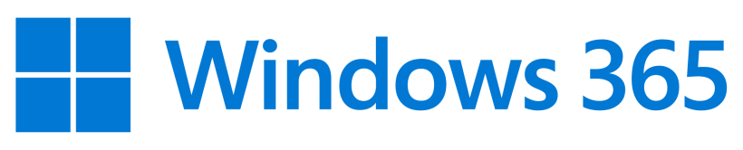

From Best-in-Class to Best-in-Suite solutions for SMBs
Work with customers to find and implement the right solutions for their needs
01
Standalones
New On-ramps to acquire customers
Microsoft 365 Suite-led
Drive NPSA and revenue
Microsoft Teams Essentials New!
Microsoft Defender for Business New!
Microsoft 365 Business Basic
Cloud services
Windows 365 Business New!
Microsoft 365 Business Standard
Cloud services and desktop apps
Microsoft 365 Apps for Business
Microsoft 365 Business Premium
Cloud services, desktop apps, and comprehensive security
Exchange Online
Note: Not all features/product logos shown.
Notes:
With a complete line up of plans, you are able to pick a solution that meets the needs of your customer. Microsoft 365 offers best-in-class and best-in-suite solutions for SMBs.
Microsoft 365 offers a set of suites for small & medium businesses:
Microsoft 365 Business Basic is Best for businesses that need easy remote solutions, with Microsoft Teams, secure cloud storage, and Office Online (desktop versions not included).
Microsoft 365 Business Standard is best for businesses that need full remote work and collaboration tools including Microsoft Teams, secure cloud storage, business email, and premium Office applications across devices.
And Microsoft 365 Business Premium is best for businesses that require secure, remote work solutions with everything included in Business Standard, plus advanced cyberthreat protection and device management. Business Premium includes Microsoft Defender for Business and it is our most comprehensive offering for small and mid sized businesses in a cost effective package to address the challenges we spoke about earlier. It truly is an all-in-one solution that will help SMBs reimagine productivity in a hybrid work environment.
For customers who want point solutions, such as for collaboration and meetings or endpoint security, Microsoft offers new standalone solutions to help partners acquire new customers to Microsoft 365. These solutions are on ramps for customers to get introduced to Microsoft 365 and eventually upsell to Microsoft 365 suites.

Slide 7
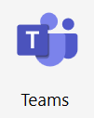
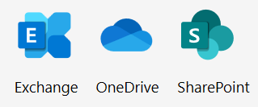
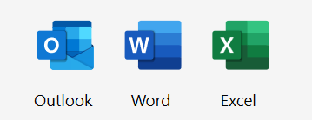
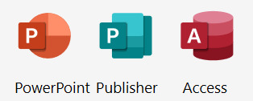




Microsoft 365 suites offerings for small & medium businesses
01
Microsoft 365 Business Basic
Cloud Services
Microsoft 365 Business Standard
Cloud Services
Microsoft 365 Business Premium
Cloud Services
Desktop Apps
Desktop Apps
$6 per user/month
$12.50 per user/month
Comprehensive Security
Azure AD Premium
Windows Virtual Desktop
Microsoft Defender
$22 per user/month
Note: Not all features/product logos shown.
Price is subject to change based on subscription term, currency and region
Notes:
Microsoft 365 suites offerings for small & medium businesses:
Microsoft 365 Business Basic is Best for businesses that need easy remote solutions, with Microsoft Teams, secure cloud storage, and Office Online (desktop versions not included).
Microsoft 365 Business Standard is best for businesses that need full remote work and collaboration tools including Microsoft Teams, secure cloud storage, business email, and premium Office applications across devices.
And Microsoft 365 Business Premium is best for businesses that require secure, remote work solutions with everything included in Business Standard, plus advanced cyberthreat protection and device management. Business Premium includes Microsoft Defender for Business and it is our most comprehensive offering for small and mid sized businesses in a cost effective package to address the challenges we spoke about earlier. It truly is an all-in-one solution that will help SMBs reimagine productivity in a hybrid work environment.

Slide 8
Standalones as pathways to upsell customers to Microsoft 365 suite
01
Already owned
Add standalone
Upsell to
Apps for Business or OnPrem Office
Teams Essentials
Business Premium or Business Standard
Upsell Microsoft 365 Business Premium customers to Windows 365
Teams Essentials
Exchange Online or Office Perpetual
Teams Essentials
Business Premium or Business Standard
Business Basic or Business Standard
Microsoft Defender for Business
Business Premium
Defender for Business
Apps for Business or OnPrem Office
Microsoft Defender for Business
Business Premium
60% of partners surveyed shared that most SMB customers start with a small standalone software deployment and then incrementally add more solutions and services over time.¹
1. Meeting the Changing Software Technology Needs of SMBs, Forrester Consulting, September 2022
Notes:
Here you can see what upsell pathways with standalones can look like.
Teams Essentials as an add-on for customers who have meetings and collaboration needs.
Microsoft Defender for Business as an add-on for customers looking for endpoint protection. Defender for Business is included, along with additional security value, in Business Premium.
For customers on Business Premium, Windows 365 is an upsell opportunity to unlock hybrid work with cloud PC.

Slide 9
Help SMBs get more out of their tech investments
Offer value-added, managed services for greater profitability
02
Ad-hoc 3rd party solutions
Customer needs
Partner + Microsoft
^{Single sign on}
Do More
Offer managed services to customers to realize value of the solution and be more effective
^{Conditional Access} ^{+ MFA}
>$45 per mo.
^{Endpoint anti-virus} ^{protection}
^{EDR}
Realize cost savings for SMBs by consolidating onto Business Premium
^{Device management}
Microsoft 365 Business Premium
Productivity apps and file storage
$22 per mo.
^{Chat based collaboration}
Notes:
The 2nd partner opportunity is to offer value-added, managed services for greater profitability.
One clear manifestation of this is by helping customers save with vendor consolidation. Customer needs can be met through a number of different apps from different vendors. And the monthly costs can really add up. With M365 Business Premium, they are able to collaborate with productivity apps, communicate with colleagues and clients, manage devices from one place, and do this all securely. Partners can help customers realize cost savings by consolidating on to Business Premium. By going the way of the suite, they can be more efficient with their tech solution investments, which opens the door for you as the partner, to help them do more. Offer managed services to help them more quickly realize the value of their solution and be more effective.

Slide 10
Managed services opportunity with vendor consolidation
02
Ad-hoc 3rd party solutions
Customer needs
Partner + Microsoft
^{Single sign on}
Do More
Offer managed services to customers to realize value of the solution and be more effective
^{Conditional Access} ^{+ MFA}
>$45 per mo.
^{Endpoint anti-virus} ^{protection}
^{EDR}
Realize cost savings for SMBs by consolidating onto Business Premium
Nearly half of SMB survey respondents ranked the ability to show ROI or potential productivity gains as significantly impacting software solution purchase decisions.¹
^{Device management}
Microsoft 365 Business Premium
Productivity apps and file storage
$22 per mo.
^{Chat based collaboration}
1. Meeting the Changing Software Technology Needs of SMBs, Forrester Consulting, September 2022
Notes:
In fact, nearly half of SMB survey respondents ranked the ability to show a return on investment as significantly impacting their decisions for purchasing software solutions.

Slide 11

Microsoft 365 Business Premium Your path to increasing profitability
02
Meet customer needs for increased security
Manage with ease with Lighthouse/RMM
Standardize on one solution across the SMB stack
Create ongoing revenue with managed services
“Since basing a managed service offering on Microsoft 365 Business Premium, profitability per employee has shot up by 250 percent.”
-- Martin Liljenberg: CTO and Cofounder, WeSafe
Notes:
To summarize, Business Premium offers a complete solution to meet SMB customer needs across productivity and security. By standardizing on BP, customers can realize cost savings on their tech solution while also enabling partners to help them do more with managed services.
For the partner, you can gain operational efficiencies and easily create an ongoing flywheel of ongoing revenue with additional managed services. Partners can easily manage this stack using M365 Lighthouse or RMM solutions. For one partner, by standardizing their offerings on Microsoft 365 Business Premium, they have seen profitability per employee shoot up by 250 percent.

Slide 12
How to pitch Do More with Less to SMBs
FY23 SMB solution plays
Digital Workforce
Security
Cloud PC
1
2
3
Digital Workforce
Teams Essentials
Microsoft 365 Suites
Seamless Security
Microsoft 365 Business Premium Microsoft Defender for Business
NextGen Windows Experiences
Windows 365
Customer solution: Support a hybrid work culture with seamless digital transformation.
Customer solution: Use a single, comprehensive solution to run your business securely from anywhere.
Customer solution: Run your business securely, using the most modern operating system, from anywhere on any device.
SMB Workshops
Notes:
To help partners in this endeavor, we are introducing Do More With Less messaging, content, and 2 new offers.
On the content BOM side, there are updated solution plays and SMB workshops for partners to leverage with the Do More With Less messaging included.

Slide 13
Get More with Microsoft 365 Today
What is the SMB New Customer and Upsell Promo?
Offer: Eligible customers receive 16% off the NCE Monthly Commitment price throughout the duration of the promotion period for the following products, which effectively sets monthly commitment pricing to annual commitment pricing.
Audience: (1) New to Microsoft Customers, as defined by new tenant creation (2) Existing Microsoft customers upgrading to a more premium product
Channels: CSP and Direct
Geographies: All geographies where Microsoft 365 is sold
Period: September 1, 2022 through June 30, 2023. Promotional pricing will stop applying at the first monthly anniversary after June 30, 2023.
Products:
Microsoft 365 Business Basic Microsoft 365 Apps for Business
Microsoft 365 Business Standard Microsoft Teams Essentials
Microsoft 365 Business Premium Microsoft Defender for Business
At the end of the promotional period, customers will automatically renew into Monthly Commitment at standard prices. Customers may be able to keep their subscription at promotional pricing by transitioning to an NCE Annual commitment at list price. Partners should decide with their customers whether an Annual or Monthly commitment makes most sense based on customer need and credit risk.
For more details about the SMB New Customer and Upsell Promo, visit the SMB Partner Portal page.
Notes:
On the offers side, we are introducing the SMB New Customer and Upsell Promo, effective beginning 9/1/22 through 6/30/23.
Eligible customers receive 16.7% off the NCE Monthly Commitment price throughout the duration of the promotion period for the following products, which effectively equalizes monthly commitment pricing to annual commitment pricing during the promotional term.
There are two types of customers eligible for this promotion:
New Customers purchasing Microsoft 365 for the first time – This promotion creates immediate cost savings both in product value and price point for new customers while allowing customers and partners to retain the flexibility of a monthly commitment.
Existing Customers upgrading to a more premium product and/or expanding their product portfolio – This promotion is a fantastic opportunity for partners to explore with their existing customers how upgrading to products like Microsoft 365 Business Premium – or expanding their Microsoft 365 investment with standalone products like Microsoft Defender for Business – can save existing customers money through vendor consolidation while providing necessary productivity and security value. Partners can leverage this promotion during their legacy to NCE transition customer conversations to pitch the opportunity to upgrade and/or expand their Microsoft investment at the discounted promotion price and monthly term flexibility.
We encourage partners to think about both audiences as they build plans for communicating this promotion with new and existing customers.

Slide 14
Partner Guidance on the Promotion
Partners should use the promo to:
Expand your pipeline by acquiring new, more speculative customers and adjust licensing as you learn their needs.
Acquire new customers with promotional pricing. Avoid cancellation risk by offering monthly commitment at annual commitment pricing.
Turn every Legacy to NCE transition discussion into an upsell conversation, leading with Security.
Focus on Business Basic and Business Standard customers on legacy commerce for attach or upsell.
Example Customer Scenarios | Lead With | Fallback to | Benefits
New-to-Microsoft Customers | Microsoft 365 Business Premium as the best value suite for customers | Microsoft Teams Essentials for meetings, calling, and collaboration Microsoft Defender for Business for endpoint protection | Immediate cost savings Flexibility of monthly commitment
Existing Business Basic Customers | Upsell to Microsoft 365 Business Premium as the best value suite for customers | Attach Microsoft Defender for Business for endpoint protection | Immediate cost savings through vendor consolidation Additional security and productivity value
Existing Business Standard Customers | Upsell to Microsoft 365 Business Premium as the best value suite for customers | Attach Microsoft Defender for Business for endpoint protection | Immediate cost savings through vendor consolidation Additional security value
Notes:
Partners should use this promotion to generate new revenue through new customer acquisition and existing customer upsell. SMBs are looking for ways to “Do More with Less”, and Microsoft 365 provides the best way to do that. Partners can use these offers as door openers to start a conversation around “Do More with Less” for both new and existing customers. Four things that every partner should consider:
Acquire new customers and avoid cancellation risk by offering monthly commitment at annual commitment pricing.
Expand your pipeline by acquiring new, more speculative customers and adjust licensing as you learn their needs.
Turn every NCE transition discussion into an upsell conversation, leading with Security
Focus on Business Basic and Business Standard legacy IB for upsell to Business Premium or attach with Defender for Business.

Slide 15
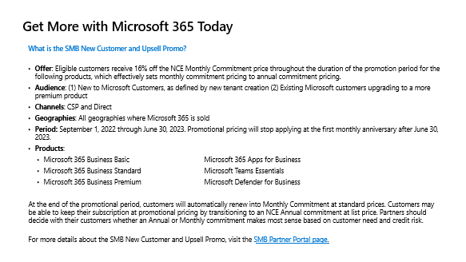
How Microsoft 365 helps Partners to leverage this opportunity
Next steps
Use the updated Solution Plays and SMB Workshops to pitch how Microsoft 365 can help SMBs do more with less.
Leverage the new Microsoft 365 offer for SMBs in your customer conversations with new and existing customers!
For Do More With Less for SMBs assets and the Offer FAQ, check out the Modern Work SMB Partner Portal.
Get Started with Microsoft 365 Today
Acquire new customers to Microsoft with promotional pricing
Add Security to Do More with Less
Turn every NCE transition interaction into an
upsell conversation
Notes:
To wrap up, cost-savings is top of mind globally for small and medium businesses, and Microsoft 365 provides best value suites and best-in-class products to help every small business achieve more. Partners should leverage the Do More With Less campaign and the offer to meet with customers now, understand their needs, provide them the right solution, and offer them managed services to do more, now.

Slide 16
Resources for Partners
Do More with Less in SMB
at SMB Partner Portal https://aka.ms/SMBPartnerPortal
Modern Work SMB Workshops
SMB Workshops at aka.ms/SMBWorkshopPartnerPortal
Microsoft Defender for Business
Partner BOM at aka.ms/MDBPartnerKit
Live and on-demand partner webinars https://aka.ms/M365MDBSeries
Windows 365
Partner BOM at aka.ms/W365Partnerportal
Windows 365 CSP Trial program FAQ at aka.ms/w365partnerfaq
Teams Essentials
Partner BOM at aka.ms/TEPartner
Teams Essentials Profitability Calculator
Forrester
Modern Work Total Economic Impact Study: aka.ms/MWForresterTEI2022
Modern Work SMB Thought Leadership Paper: https://aka.ms/FY23SMBTLP
Microsoft 365 Business Premium
Partner Playbook at aka.ms/M365BPPartnerPlaybook
Upsell Guides:
Exchange Online to Business Premium​
Business Standard to Business Premium ​
Business Basic to Business Premium
Notes:
Additional resources for partners

